Slide 1
Some Thoughts and Viewpoints about Research Study
09th Sept 2016 by shanjiang Tang

Slide 2
Targeted Listeners
Students
  Master students
  Ph.D. students
Teachers
  Assistant professors
  Associate Professors
  Professors

Slide 3

Five Principles
Students
  Projects
  Papers
  People
Teachers
  Proposals
  Projects
  Papers
  People
  Pupils
People
Pupils
Papers
5P
Principles
Proposals
Projects

Slide 4
Being as a Master Student--Follower
Projects
  Yin Luan Ru Jin
  EasyPAB
  EasyPDP
Papers
  FJRR
  EasyPDP
People

Slide 5
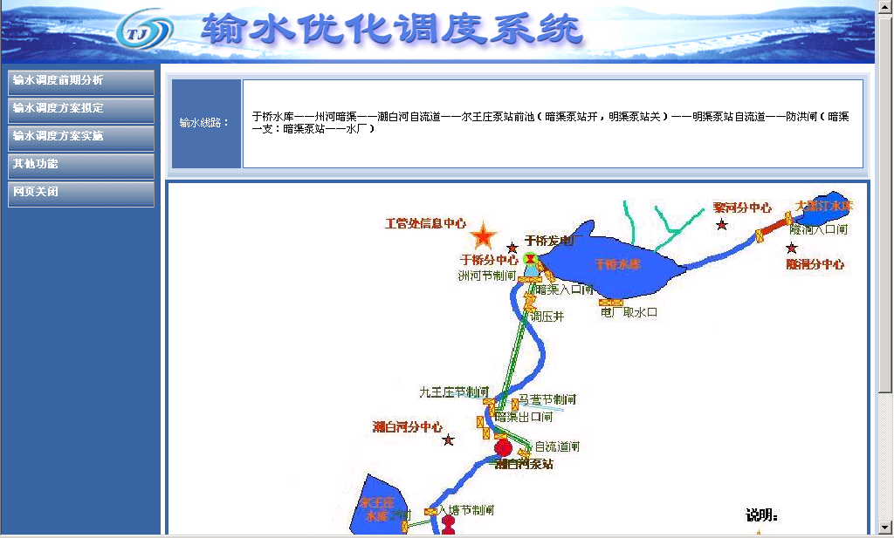
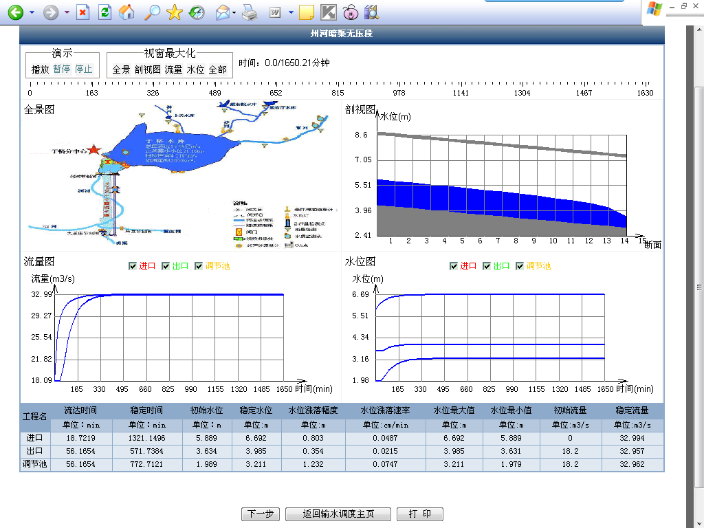
Being as a Master Student--Projects
Yin Luan Ru Jin
  J2EE development
  Interdisciplinary collaboration

Slide 6
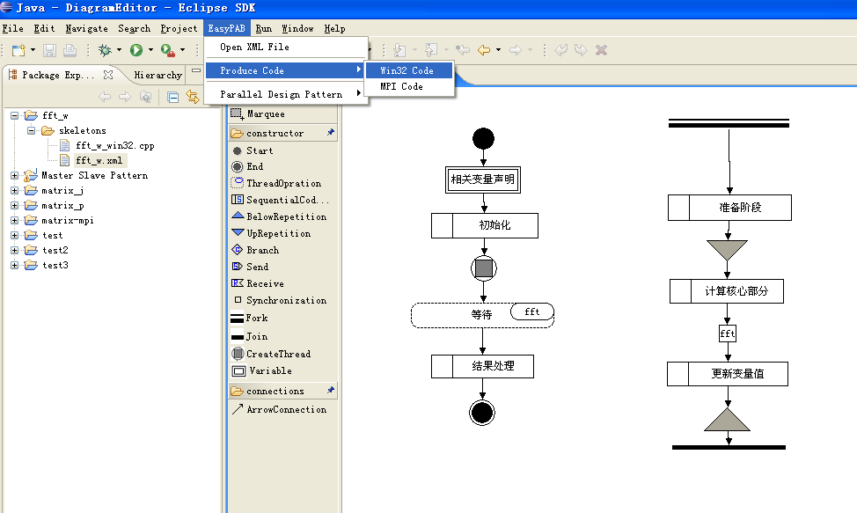
Being as a Master Student—Projects(2)
EasyPAB (R&D Project)
  Simplify parallel programming
  Visual Parallel programming

Slide 7
Being as a Master Student—Projects(3)
EasyPDP (R&D Project)
  Programming model & Computing Framework
  Simplify Parallel Dynamic Programming
  Successive Systems: EasyHPS, DPX10
  Open source

Slide 8
Being as a Master Student—Papers
FJRR: parallel design pattern for array-based data decomposition applications (计算机应用研究 2010)
Fork
Partition Portions
Data Entity
Join

Slide 9
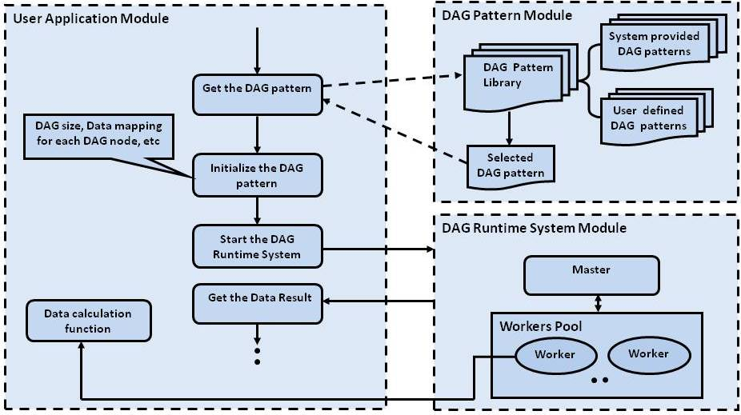
Being as a Master Student—Papers(2)
EasyPDP: An Efficient Parallel Dynamic Programming Runtime System for Computational Biology (TPDS’12)

Slide 10
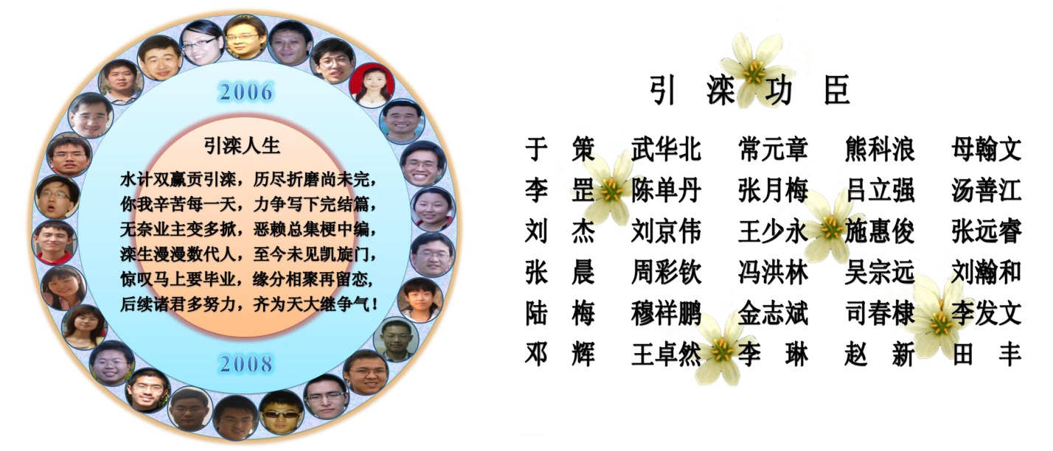
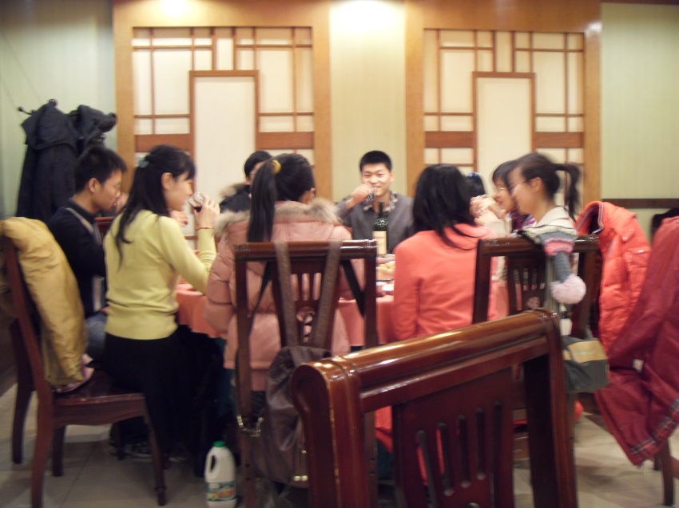
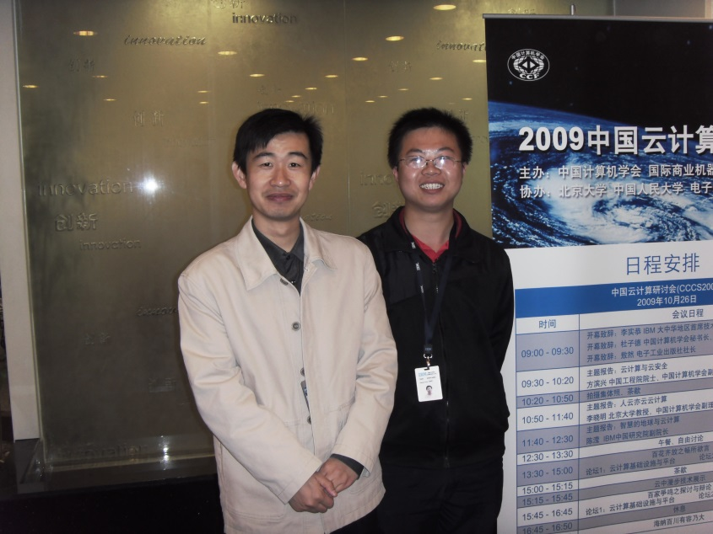
Being as a Master Student—People

Slide 11
Being as a Ph.D. Student—Explorer/Leader
Projects
  E-Amdahl’s Law
  MROrder
  DynamicMR
  LTYARN
  EMRF
Papers
  MROrder, DynamicMR, LTYARN, EMRF, etc.
People

Slide 12
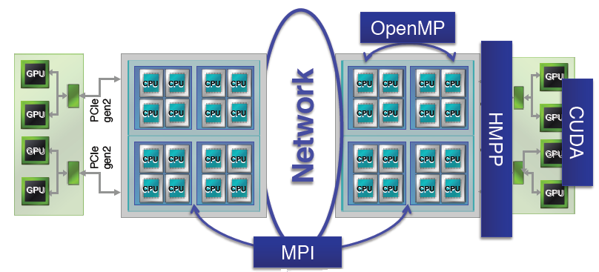
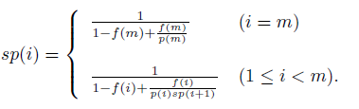
Being as a Ph.D. Student--Projects
E-Amdahl’s Law
  Extend Amdahl’s Law to multi-level parallel computing model
  MPI+OpenMP, MPI+CUDA, MPI+OpenMP+CUDA

Slide 13
Being as a Ph.D. Student—Projects(2)
MROrder
  In Hadoop v1, map tasks run on map slots only, reduce tasks run on reduce slots only.
  Exchange job submission order can improve the overall performance of the system.
time
Map Phase :
Reduce Phase :
time
Map Phase :
Reduce Phase :

Slide 14
Being as a Ph.D. Student—Projects(3)
DynamicMR
  In Hadoop v1, map tasks run on map slots only, reduce tasks run on reduce slots only.
  Solution: allow map tasks to use map/reduce slots, and vice versa for reduce tasks.

Slide 15
Being as a Ph.D. Student—Projects(4)
LTYARN
  Amazon EC2 Cloud: Pay-as-you-go (on-demand instance, reserved instance, spot instance)
  Hadoop Fair Scheduler: memoryless, which is not suitable for on-demand/reserved instances.
  Solution: Long-term Resource Fairness

Slide 16
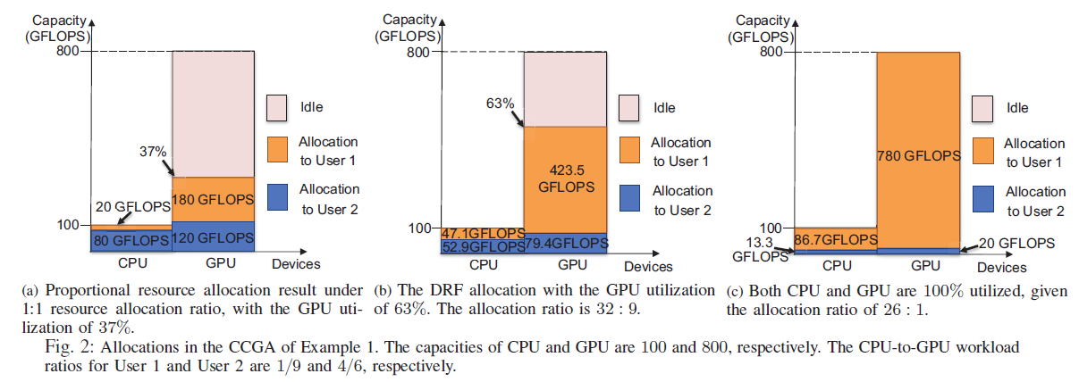
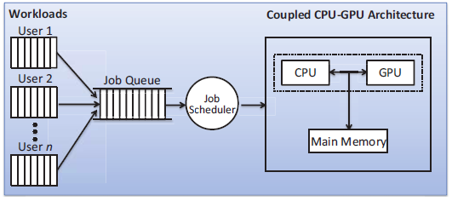
Being as a Ph.D. Student—Projects(5)
EMRF
  Tradeoff between Fairness vs Efficiency
  Coupled CPU-GPU Architecture, e.g., APU.

Slide 17
Being as a Ph.D. Student—Papers
E-Amdahl’s Law (IPDPSW’12)
MROrder (Euro-Par’13, TSC’16)
DynamicMR (Cluster’13, TCC’14)
LTYARN (ICS’14, CloudCom’14, TSC’16)
EMRF (SC’16)

Slide 18
Being as a Ph.D. Student—Papers(2)
Paper Reading
  TOP & RECENT published CONFERENCE papers.
  Keep FOLLOWING TOP CONFERENCE in your domains
  Keep summarizing your (initial) ideas during your paper reading (using slides, docs, etc.)
Paper Writing
  Be clear about Background & Problem, Motivation, Challenges, Solutions, Related Work. (rethink these before begin)

Slide 19
Being as a Ph.D. Student—Papers(3)
Paper Submission
  Keep eye on the incoming related conferences and prepare your work before the deadline.
  The novelty of your paper idea determines the quality of your paper
  REJECT is a common thing. DO NOT frustrate whenever it occurs.

Slide 20
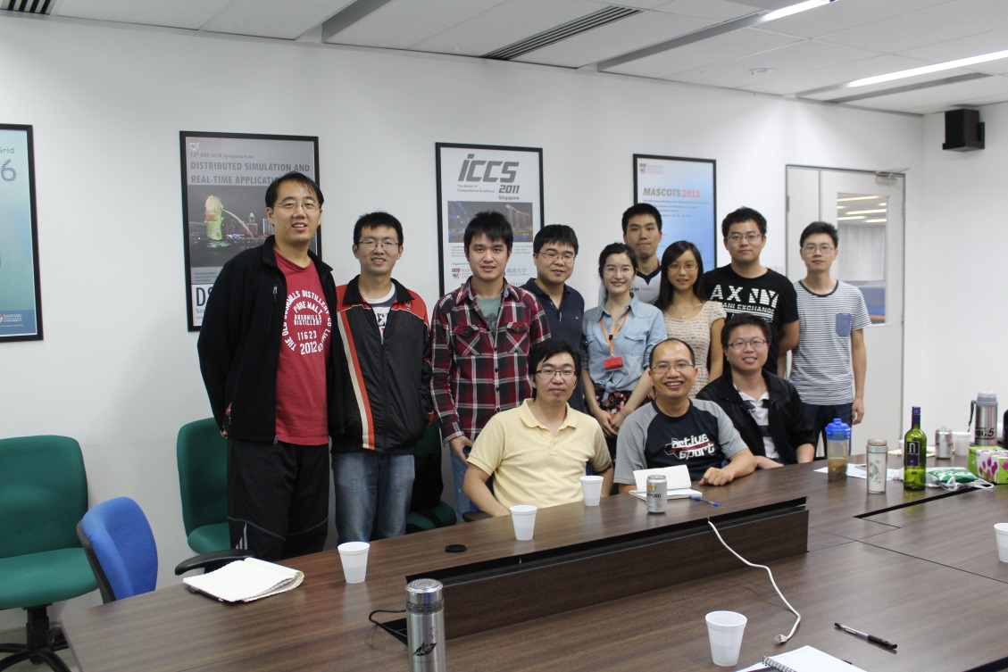
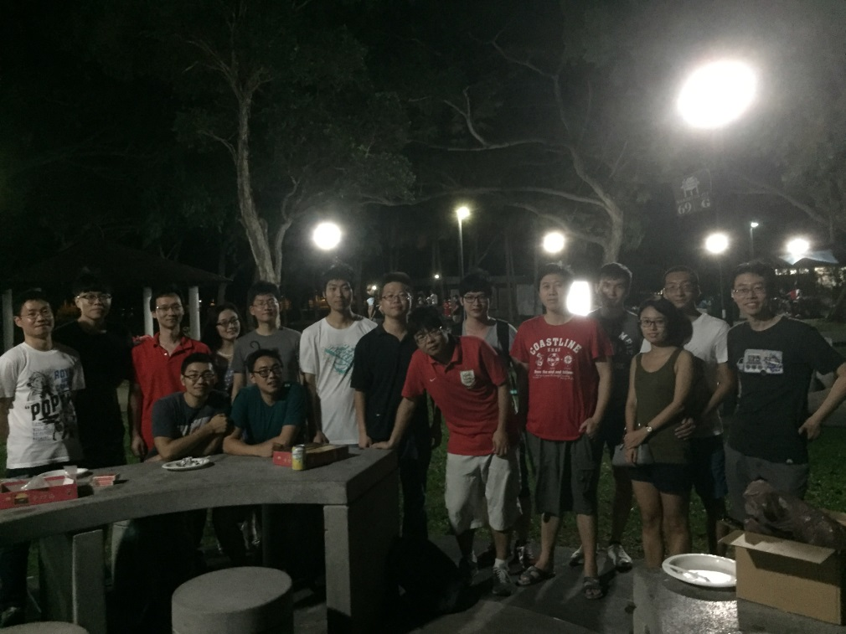
Being as a Ph.D. Student—People
DO be active in your team and cooperate with other people willingly.
  Be an independent, active and confident researcher
  Be friendly and thankful to your friends.

Slide 21
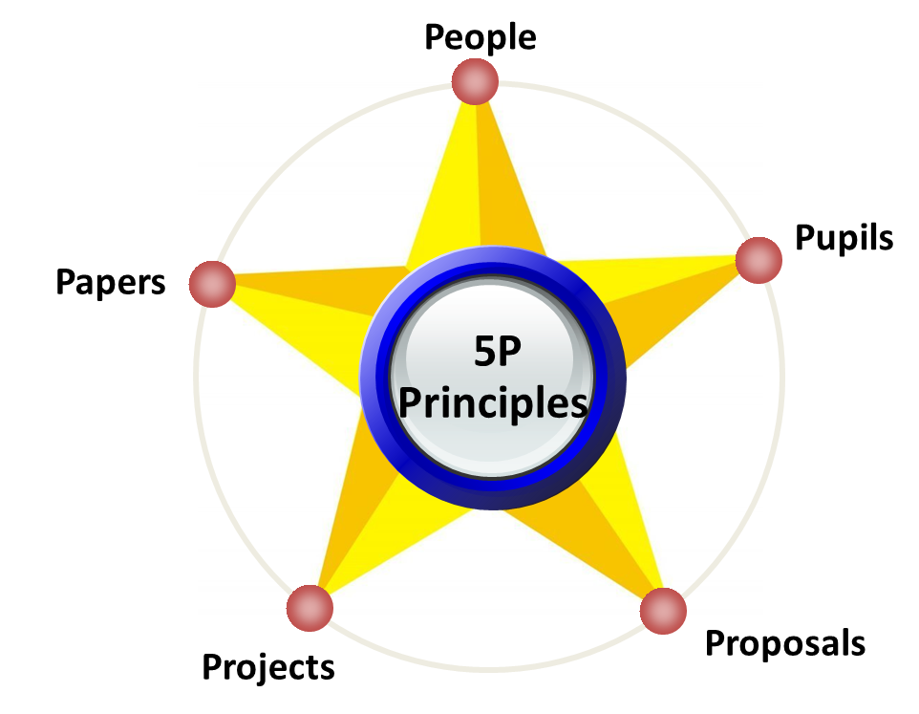

Being as a Teacher
Keep in mind the 5P principles strictly.
  Balance the time expense for each P
  Prioritize 5P at different stages
  Manage and lead a team (Direction, Resources, Plan)

Slide 22
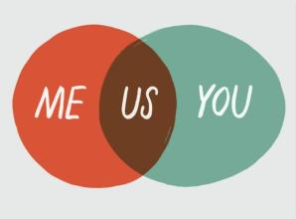
Being as a Teacher—People
Social is a must.
  Try every opportunity (e.g., conference, workshop, talk) to get familiar with strong experts in your domain directly and indirectly.
  Keep in touch often with your friends, teachers, classmates, etc.

Slide 23
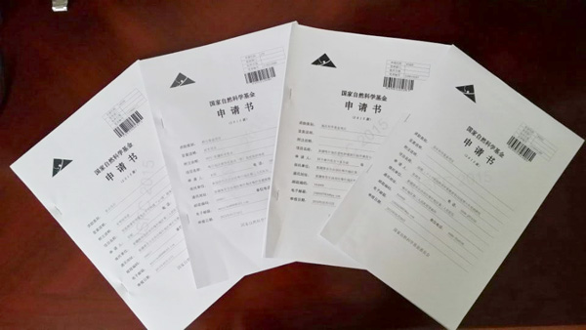
Being as a Teacher—Proposals
A very important thing for every teacher.
  A direct way to get funding support for research.
  A plan and research direction.
  A good manner to establish cooperation with others.

Slide 24
Being as a Teacher—Projects
Be a responsible leader in the project
  Know what we have and what we need.
  Keep track of the progress of the project in hand.
  Know who can solve it when there is a problem.
  Lab Demo -> Production Software (e.g., Spark)

Slide 25
Being as a Teacher—Pupils
Course Teaching
  Knowledge transfer process. (Teaching style, content updates)
  Acting as a Supervisor
  Research guidance.
  Team Partner/Collaborator
  Making opportunities/resources for students (e.g., oversea study, job opportunity)

Slide 26
Being as a Teacher—Papers
A key metric for quantifying the research capability of a team/person
  Paper Reading: keep track of the latest published top conference papers (assign papers to students)
  Paper Formulation: evaluating the feasibility /difficulty/novelty/ of a problem/idea.
  Paper Revision: comments on students’ papers and help revise it.
  Paper Writing: mainly incentivize and guide students on how to write papers.

